Slide 1
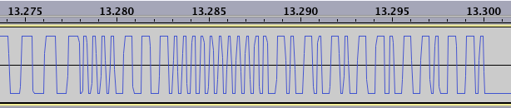
00011100
00000000
01010101
10110110
1C
00
55
B6
perl -e 'printf "%02X\n",0xFF ^ 0x1C ^ 0x00 ^ 0x55'

Slide 2
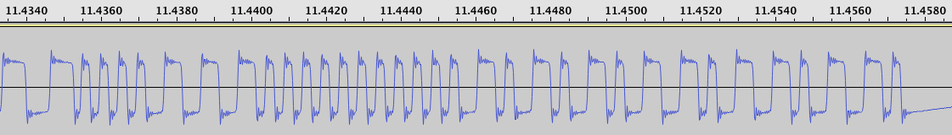
00011100
00000000
01010101
10110110
1C
00
55
B6
SYNC
BIT
770Hz PREAMBLE
001C LENGTH
RUN BIT
CHECKSUM

Slide 3
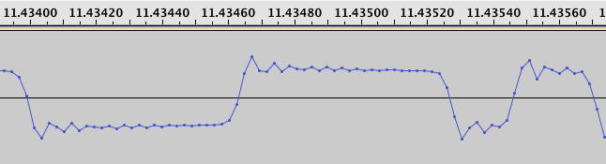
28 Negative Samples
28 Positive Samples
8 [-]
11 [+]
770 Hz Preamble
SYNC Bit

Slide 4
